Slide 1



WELCOME
F Y B Tech Students
to the
Engineering Physics Course

Slide 2
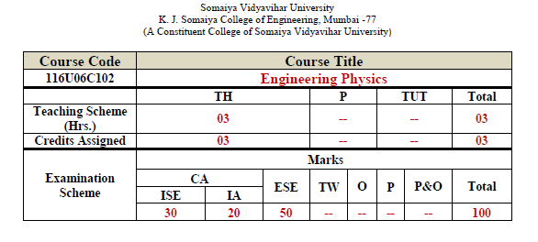

Slide 3
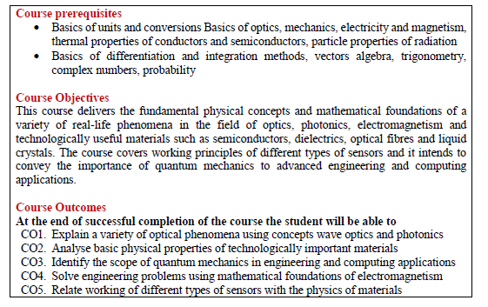

Slide 4
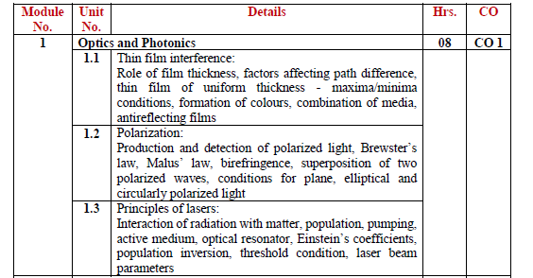

Slide 5
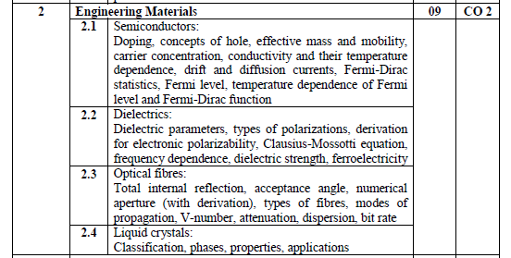

Slide 6
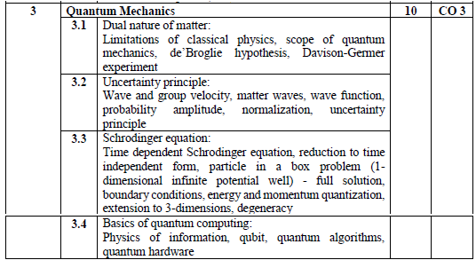

Slide 7
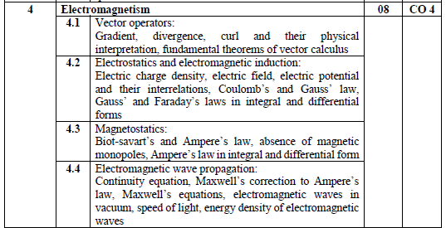

Slide 8
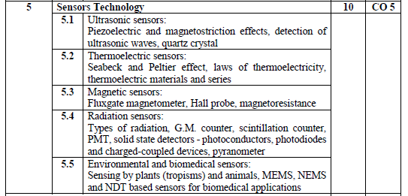

Slide 9
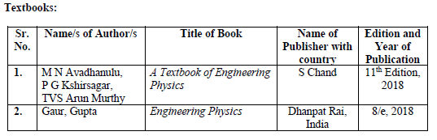

Slide 10
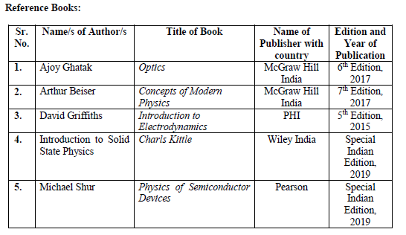

Slide 11

Thin film interference

Slide 12
Interference
The phenomenon of modification in intensity of light due to mixing/superimposing of two or more light waves is called Interference of Light.

Slide 13
Constructive and Destructive Interference
E₁ + E₂
E₁
E₂
Constructive Interference E = E₁ + E₂
E₁
E₁ - E₂
1st Wave (E₁)
2nd Wave (E₂)
Resultant Wave
Reference Line
E₂
Destructive Interference E = E₁ - E₂

Slide 14


Phase difference (Φ) = (2 π /λ) path difference
Condition for Constructive Interference :
Phase difference Φ = 2nπ
Path difference = n λ
where n = 0, 1, 2, 3, …….
Condition for Destructive Interference :
Phase difference Φ = (2n $±$1)π
Path difference = (2n $±$ 1) λ / 2
where n = 0, 1, 2, 3, ……. for +ve
where n = 1, 2, 3, ……. for - ve

Slide 15
Conditions for sustained interference
The two sources must be coherent.
2. The sources must be monochromatic.
3. The interfering waves should have same amplitude or intensity
4. The distance between two sources should be small.
5. The perpendicular distance of screen from two sources should be large.
6. Sources must be narrow.
7. The two interfering waves must have the same plane of polarization.

Slide 16
Methods for obtaining Coherent Sources
Division of Wavefront
Examples: Young’s double slit, Biprism etc
Division of Amplitude
Examples: Thin film, Newton’s Ring etc

Slide 17
Division of Wavefront

Slide 18


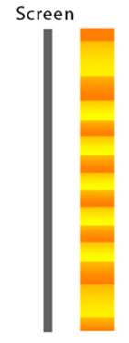
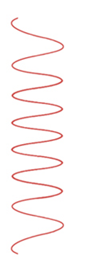
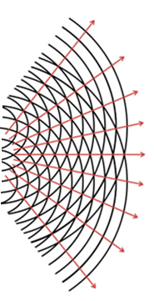

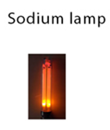
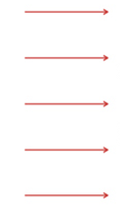
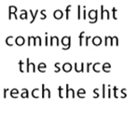
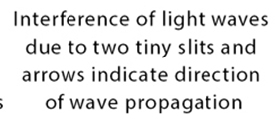

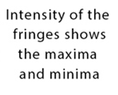
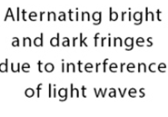

Slide 19
Division of Amplitude

Slide 20
Incident ray, λ
Ray 1
Ray 2
Reflected system
Transparent medium
Transmitted system
Let’s discuss about reflected rays 1 and 2
Hence they will interfere Reflected system
In this, intensity or amplitude of waves changes.
Hence it is called Interference due to Division of Amplitude

Slide 21
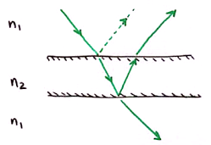
Thin Film
When a film of oil spread over surface of water is illuminated by white light , beautiful colours are seen.
This is due to interference between the light waves reflected from the film and the light waves transmitted through the film.
Thin film may be a thin sheet of transparent material such as glass, mica or an oil film enclosed between two transparent sheets or a soap bubble.

Slide 22

1. Parallel Rays interference with each other?
2. How many rays will interfere ?
3. What about thickness?
Let’s discuss now
#1

Slide 23
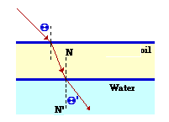
Important Note
1. Thin film:
In optics, a transparent medium having thickness (0.1 λ) to (10 λ) is called thin film.
Example: layer of oil on glass or water surface
2. Optical Path:
If light travels a distance of ‘t’ in an medium of refractive index ‘µ’,
then its equivalent path in air or vacuum is ‘µt’.

Slide 24
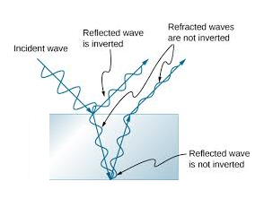
3. Reflection of Transverse waves :
No phase or path changes due to reflection from rarer medium.
Phase changes by π radian (which is equivalent to path change of λ/2) takes place, when reflection takes place from surface of denser medium.

Slide 25
Interference in thin film of uniform thickness (reflected system)
# 2

Slide 26
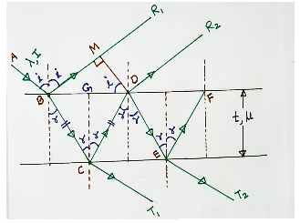
Interference in thin film of uniform thickness (Reflected System)

Slide 27
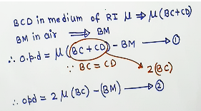
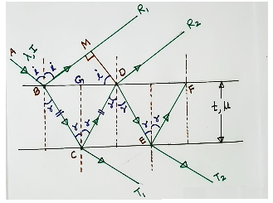
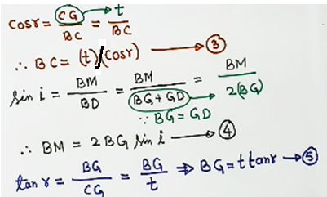
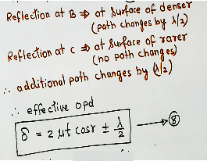
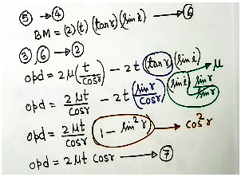

Slide 28
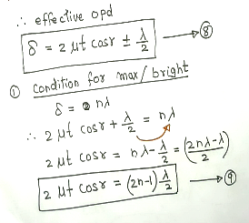
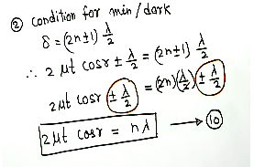

Slide 29
Interference in thin film of uniform thickness (Transmitted System)

Slide 30
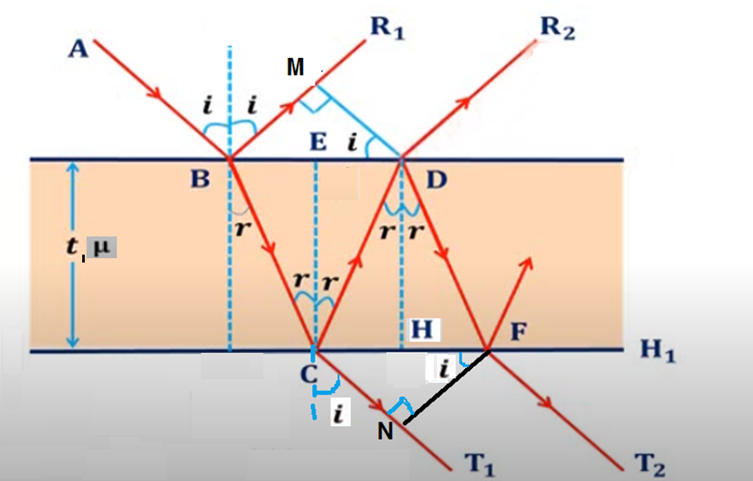

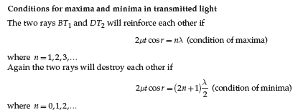
Interference in thin film of uniform thickness (Transmitted System)

Slide 31



The condition of bright in reflected system is same as condition for dark in transmitted or vice- versa.
Therefore, the colours which are present in the reflected system are absent in the transmitted system.

Slide 32
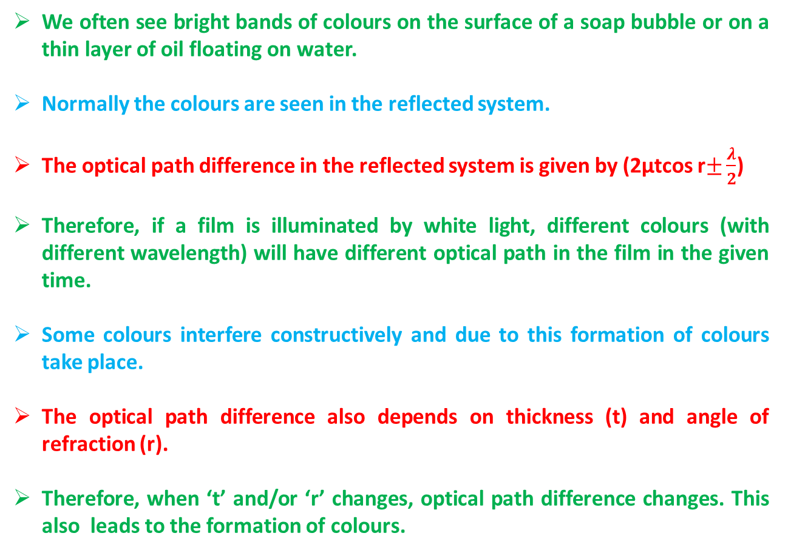
Formation of Colours in thin films :
We often see bright bands of colours on the surface of a soap bubble or on a thin layer of oil floating on water.
Normally the colours are seen in the reflected system.
The optical path difference in the reflected system is given by (2µtcos r$±\frac{λ}{2}$)
Therefore, if a film is illuminated by white light, different colours (with different wavelength) will have different optical path in the film in the given time.
Some colours interfere constructively and due to this formation of colours take place.
The optical path difference also depends on thickness (t) and angle of refraction (r).
Therefore, when ‘t’ and/or ‘r’ changes, optical path difference changes. This also leads to the formation of colours.

Slide 33
Combination of Media

Slide 34
Numerical Problems

Slide 35


Slide 36


Slide 40
Anti-reflection (AR) coating
It is a type of optical coating applied to the surface of lenses and other optical elements to reduce reflection.
This is also called highly refractive coating.
This improves the efficiency since less light is lost due to reflection.
In complex systems such as telescopes and microscopes the reduction in reflections also improves the contrast of the image by elimination of stray light.
This is especially important in planetary astronomy. It makes the eyes of the wearer more visible to others, or a coating to reduce the glint from a covert viewer's binoculars or telescopic sight.

Slide 41
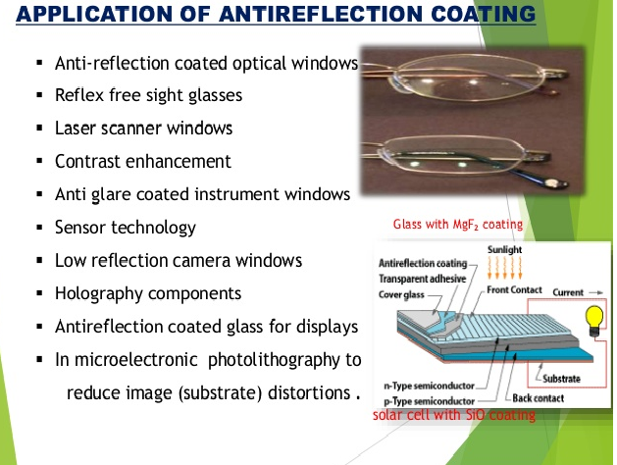
Source: https://www.slideshare.net/lovecantbpainted/anti-reflective-coatings-on-the-solar-photo-voltaic-panels

Slide 42
Derivations for Anti-reflection (AR) coating

Slide 43
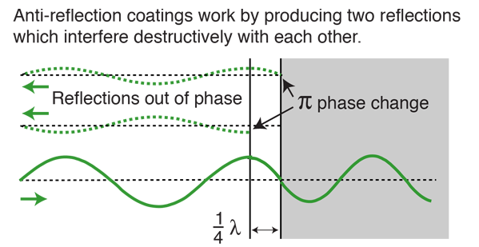
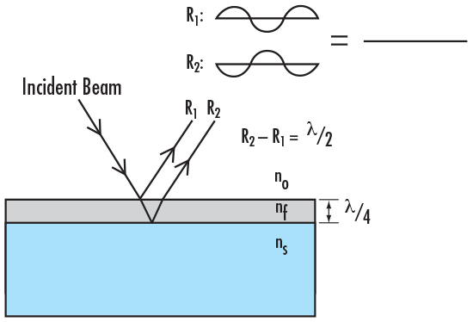
https://www.google.com/search?q=applications+of+anti+reflection+coating&rlz=1C1RLNS_enIN667IN667&sxsrf=ALeKk02pbN3aeQXuBjr8yzZEGPSpaH4jcQ:1598285253850&source=lnms&tbm=isch&sa=X&ved=2ahUKEwiwubjGnLTrAhXbxjgGHZk4B2IQ_AUoAXoECBAQAw&biw=1366&bih=657#imgrc=d4E6b1RQyYPRPM

Slide 44


